Slide 1

The Camera Sensor
Course 3, Module 1, Lesson 1 – Part 1

Slide 2
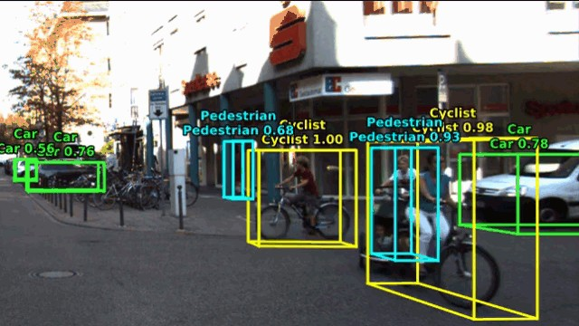
The Camera Sensor
Appearance（外観） information is particularly useful for scene understanding tasks such as object detection, segmentation and identification.
Appearance information is what allows us to distinguish between road signs or traffic lights states, to track turn signals and resolve overlapping vehicles into separate instances.

Slide 3
The Camera Sensor
Because of its high resolution output, the camera is able to collect and provide orders of magnitude more information than other sensors used in self-driving while still being relatively inexpensive.
Captures detailed appearance information
High rate of information capture
Relatively inexpensive

Slide 4
Image Formation
Image capture was originally done with film but nowadays with rather sophisticated（精巧「せいこう」） silicon chips.
basic open sensor camera design.
we’ll end up with blurry（ぼやけた） images because the imaging sensor is collecting light rays from multiple points on the object at the same location on the sensor. objectの違う点が sensorの同じ点に投影される。

Slide 5

Image Formation
solution (pinhole camera model), put a barrier（バリア、障壁「しょうへき」） in front of the imaging sensor with a tiny hole or aperture（開口「かいこう」） in its center.
The barrier allows only a small number of light rays to pass through the aperture, reducing the blurriness of the image.
Imaging Sensor
Barrier
Object

Slide 6

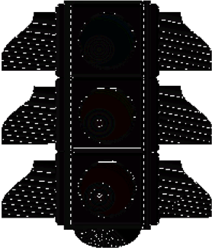


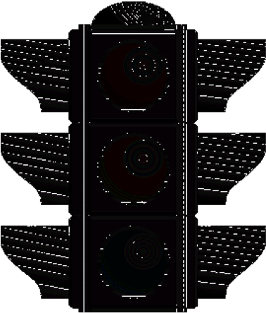

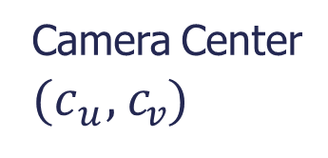
Pinhole Camera Model
Describe the relationship between a point in the world and its corresponding projection on the image plane.
Camera Center
($c_{u}$, $c_{v}$)
Focal Length f
Focal length, the distance between the pinhole and the image plane.
The focal length defines the size of the object projected onto the image.
Plays an important role in the camera focus when using lenses to improve camera performance. （次のスライド）
Camera Center, the coordinates of the center of the pinhole.
These coordinates defines the location on the imaging sensor that the object projection will inhabit.
カメラ中心と光学中心を区別しよう。

Slide 7
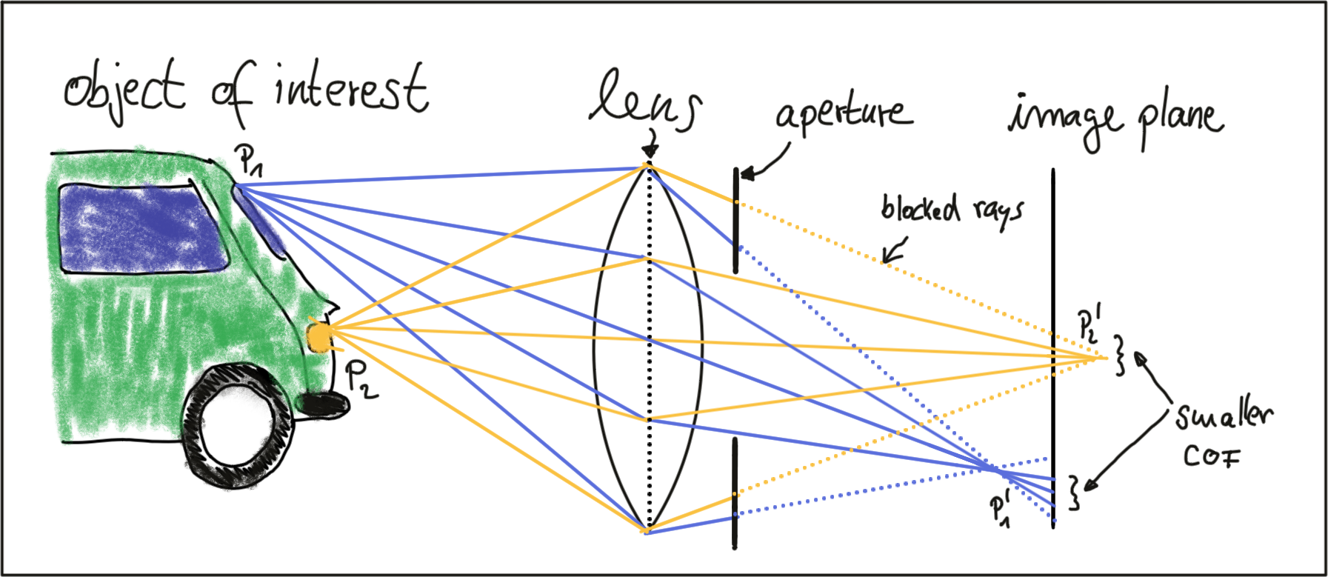
Lenses and Aperture（開口「かいこう」）（from Udacity）
A properly sized and positioned lens refracts（屈折「くっせつ」） all rays of light that emanate from a point P1 on an object in space such that they converge（収束） to a single point P1' in the image plane.
Points on the object that are closer or farther away, such as P2, appear out of focus on the image plane, because the set of light rays emanating from them does not converge in a point but rather in a circle with a finite radius instead.
This blurry circle is usually referred to as circle of confusion (COF).
To reduce blurring, an aperture can be used, which is a concentric(同心円) opening of usually adjustable size placed directly behind the lens.
By reducing the diameter of the aperture, light rays passing through the lens on the outer edges are blocked, which reduces the size of the COF on the image plane.
It can easily be seen that a smaller aperture results in reduced blurring, but at the expense of low light sensitivity.

Slide 8
Camera Projective Geometry（射影幾何学「きかがく」）
Course 3, Module 1, Lesson 1 – Part 2

Slide 9
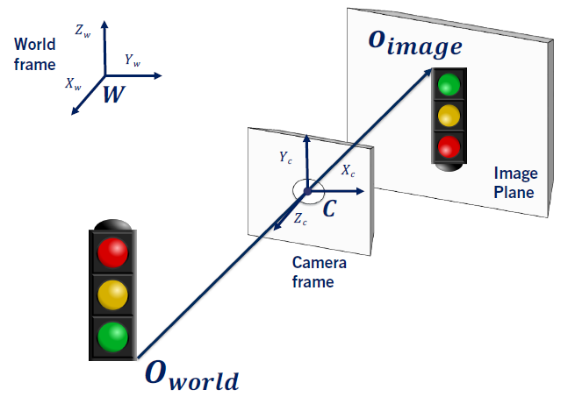
Projection: World → Image (Real Camera)
The projection onto the sensor surface through the aperture results in flipped（ひっくり返った） images of the objects in the world.
To avoid this confusion, we usually define a virtual image plane in front of the camera center.
下記のsimplified camera model.

Slide 10
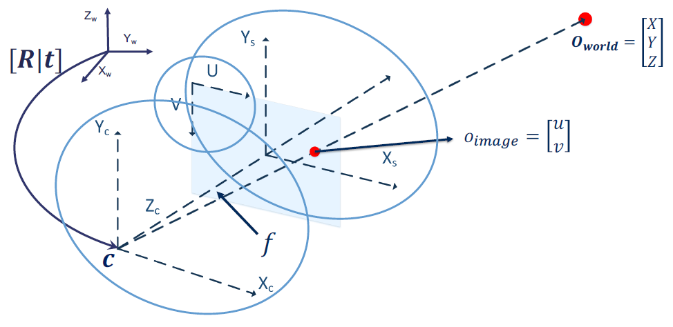
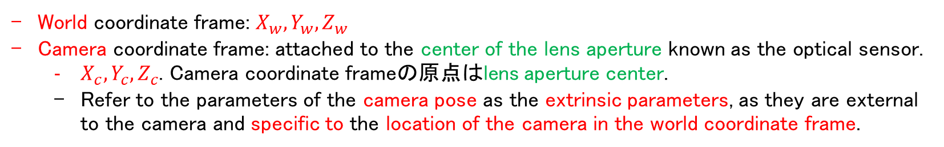
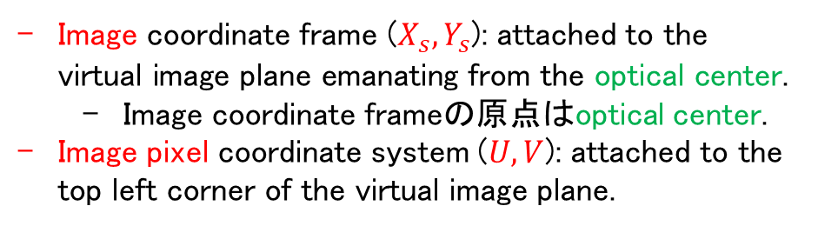
Projection: World → Image (Simplified Camera)
World coordinate frame: $X_{w},Y_{w},Z_{w}$
Camera coordinate frame: attached to the center of the lens aperture known as the optical sensor.
$X_{c},Y_{c},Z_{c}$. Camera coordinate frameの原点はlens aperture center.
Refer to the parameters of the camera pose as the extrinsic parameters, as they are external to the camera and specific to the location of the camera in the world coordinate frame.
ここは既にZを消した（2D座標系）
Image coordinate frame ($X_{s},Y_{s}$): attached to the virtual image plane emanating from the optical center.
Image coordinate frameの原点はoptical center.
Image pixel coordinate system ($U,V$): attached to the top left corner of the virtual image plane.

Slide 11
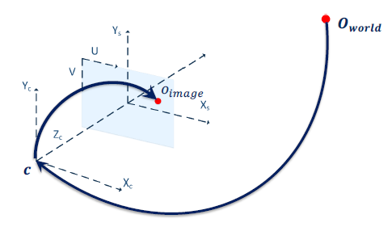
Computing the Projection
Projection form World coordinates → Image coordinates:
Project from World coordinates→ Camera coordinates
Project from Camera coordinates to Image coordinates
Transform image coordinates to pixel coordinates through scaling and offset.

Slide 12
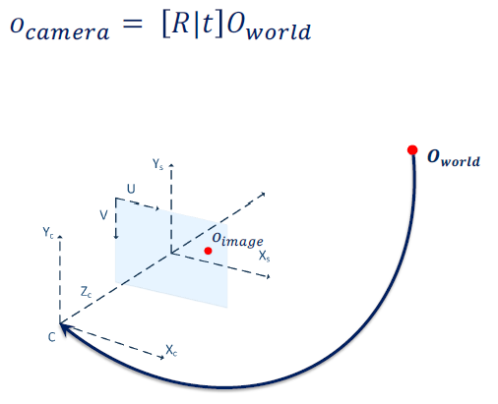
Computing the Projection
World → Camera:

Slide 13
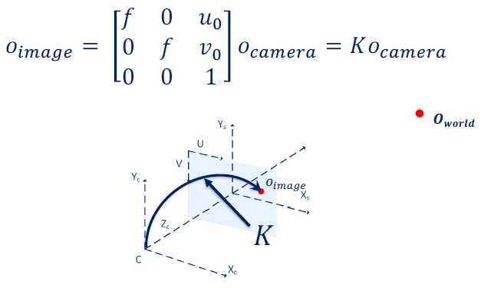
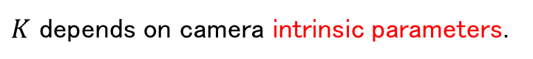
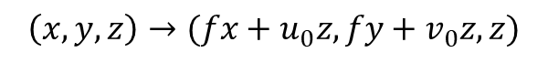
Computing the Projection
Camera → Image:
$K$ depends on camera intrinsic parameters.
変更前後のzは変わらない、だからカメラ中心を変換後は0になる。
$$\left(x,y,z\right)→(fx+u_{0}z, fy+v_{0}z, z)$$

Slide 14
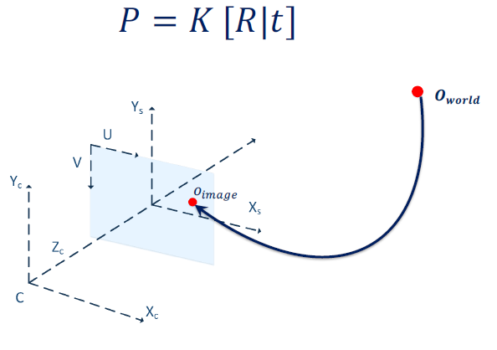
Computing the Projection
World → Image:

Slide 15
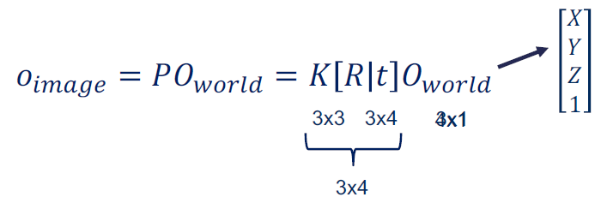
Computing the Projection
Projection from World Coordinates → Image Coordinates:
When we expect the matrix dimensions, we noticed that the matrix multiplication cannot be performed.
To remedy this problem, we transform the coordinates of into homogeneous coordinates（斉次「せいじ」座標）

Slide 16
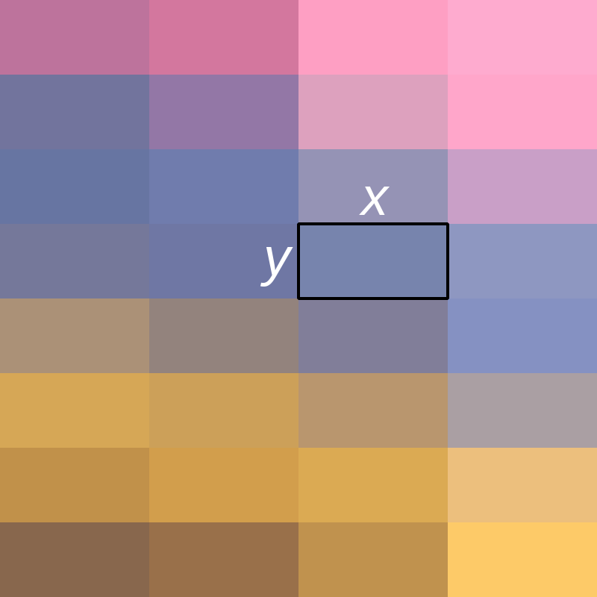
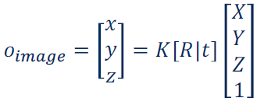
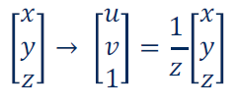
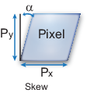
Computing the Projection
World coordinates to Image coordinates:
Image coordinates to Pixel coordinates:
Pixel skew
ピクセルアスペクト比
実際のもっと複雑な課題：non-square pixels, camera axis skew, distortion（次のスライド）, non unit aspect ratio（？）.
• Luckily, this only changes the camera K matrix.
https://www.mathworks.com/help/vision/ug/camera-calibration.html

Slide 17
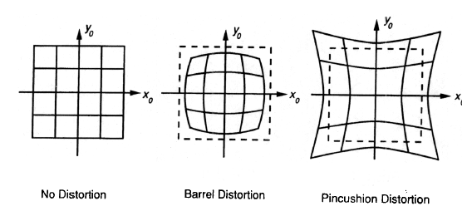
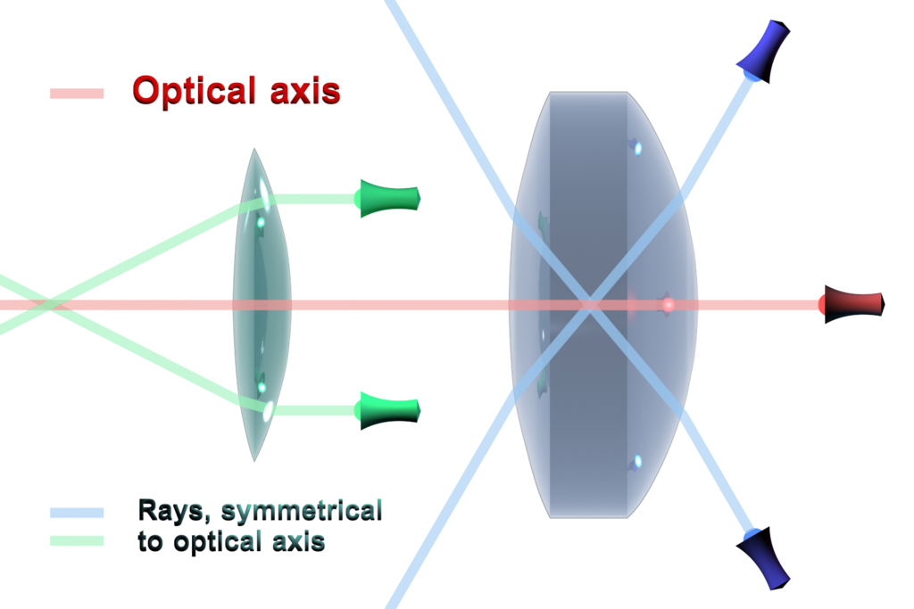
Distortion (from Udacity)
In practice, lenses introduce distortion(歪み、ゆがみ、歪曲収差、わいきょくしゅうさ) into images, depending on the lens type.
The distortion most relevant to practice is called “radial distortion“(放射状歪み).
It is caused by the focal length of the lens not being uniform over its diameter（直径）. （大事）
Therefore, the magnification(拡大、倍率) effect of the lens changes depending on the distance between the camera center (the optical axis) and the ray of light passing through the lens.
If the magnification increases, the resulting distortion effect is called pincushion(針刺、はりさし、裁縫「さいほう」用の針を刺しておくための道具) distortion.
If it decreases, it is called barrel(たる、樽) distortion.
Barrel distortion usually occur, when wide-angle lenses（広角レンズ） are used.
https://en.wikipedia.org/wiki/Optical_axis

Slide 18
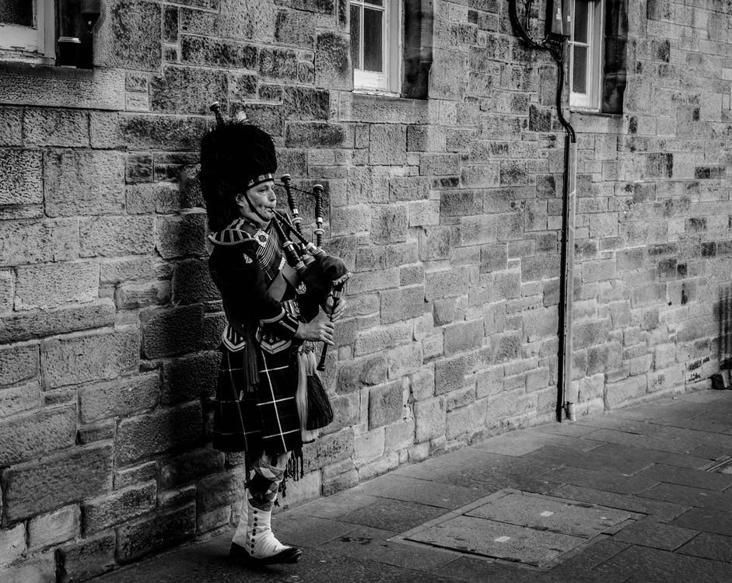


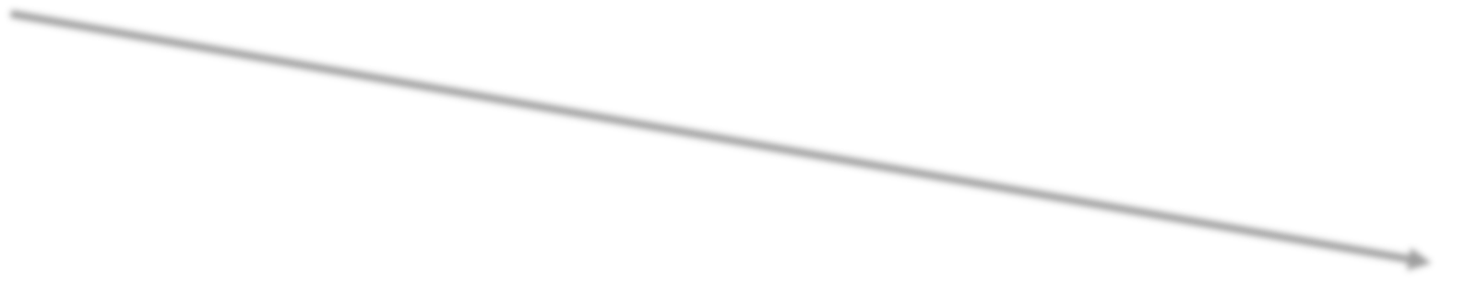
The Digital Image: Grayscale（グレースケール）
N
u
128 127 127 23
127 255 127 25
41 41 0 0
42 43 0 0
M
v
https://www.pexels.com/photo/person-using-bagpipes-near-wall-in-grayscale-photography-929791/
Each point in 3D projects to a pixel (a grid) on the image defined by the uv coordinates.
In grayscale, brightness information is written in each pixel as an unsigned 8 bit integer. (0 ~ 255).
Some cameras can produce unsigned 16-bit integers for better quality images.

Slide 19
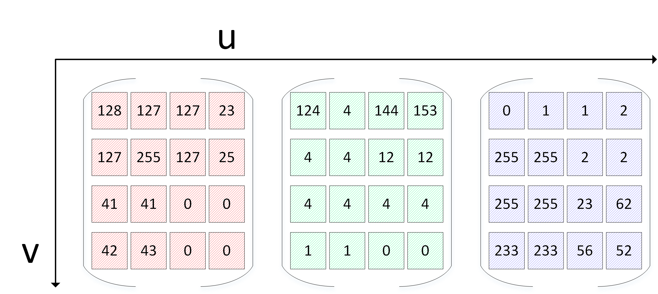

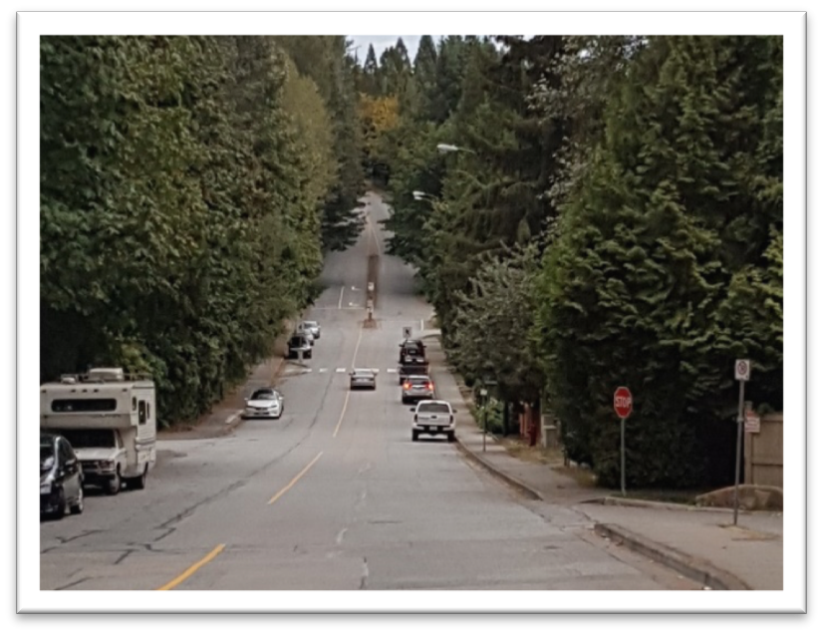



The Digital Image: Color
3
N
M
R
G
B

Slide 20
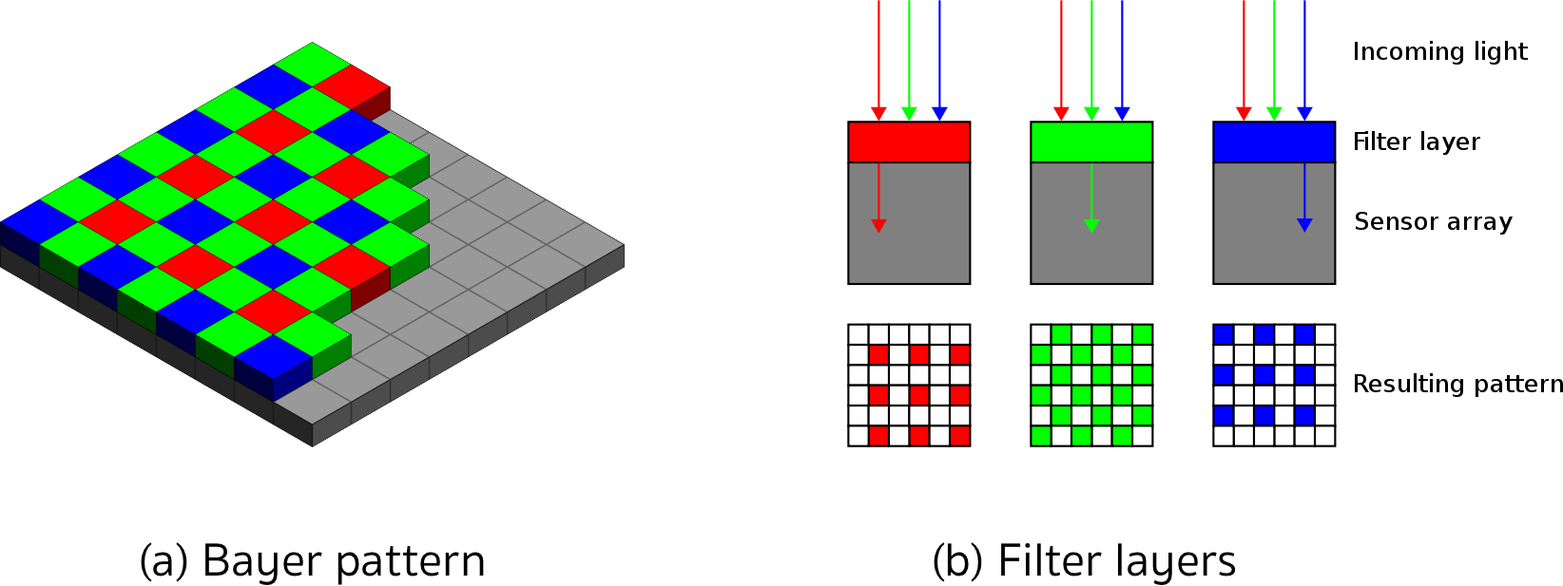
Imagers and Bayer Pattern (from Udacity)
市松模様「もよう」
ベイヤーフィルター
How rays of light with a certain wavelength are converted into color pixels that can be stored digitally.
When an image is captured by a camera, light passes through the lens and falls on the image sensor.
This sensor consists of light sensitive elements that register the amount of light that fall on them and convert it into a corresponding number of electrons.
Once the exposure time is complete, the generated electrons are converted into a voltage, which is finally transformed into a discrete number by means of an A/D-converter.
Two main image technologies: CCD(Charge(電荷「でんか」)-Coupled Device、電荷結合素子「そし」) and CMOS(Complementary Metal-oxide Semiconductor). （大事）
Both technologies convert electrons into voltage and are inherently color blind（色覚「しきかく」異常）, as they can not distinguish the different wavelengths which generate the electrons.
To enable color vision, tiny filter elements (also micro-lenses) are placed in front of each pixel which only allow a certain wavelength to pass through.
One way to map wavelength to color is to arrange the filter elements in an RGB (Red, Green, Blue) pattern to allow primary colors（原色「げんしょく」） to pass through individually, which gives us three individual images - one for each primary color. 面白い！
When each discrete color value is coded with 8bits (i.e. 256 values), a total of 16.7 million different colors can be created with the RGB filter concept.
The most common way of arranging the RGB filters is called a Bayer pattern, which has alternating（互い違い「たがいちがい」） rows of red-green and green-blue filters. つまり１つのpixelの前に３つfilterを置くのは無理？つまりR,G,Bの各channel matrixに実はたくさんのところに値なし(0?)？
Since the human eye is more sensitive to green that to red or blue, the Bayer array has twice as many green color filters.

Slide 21
Camera Calibration
Course 3, Module 1, Lesson 2

Slide 22
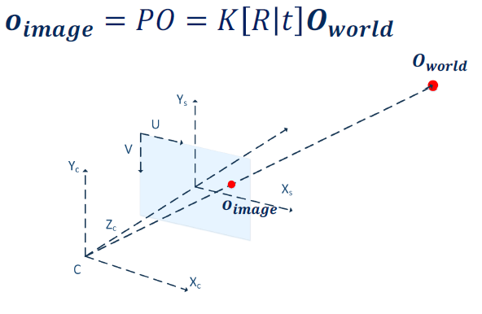
Computing the Projection
Projection from World → Camera:

Slide 23
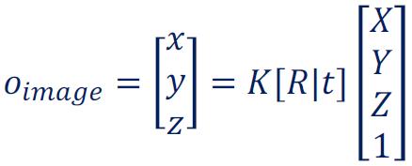
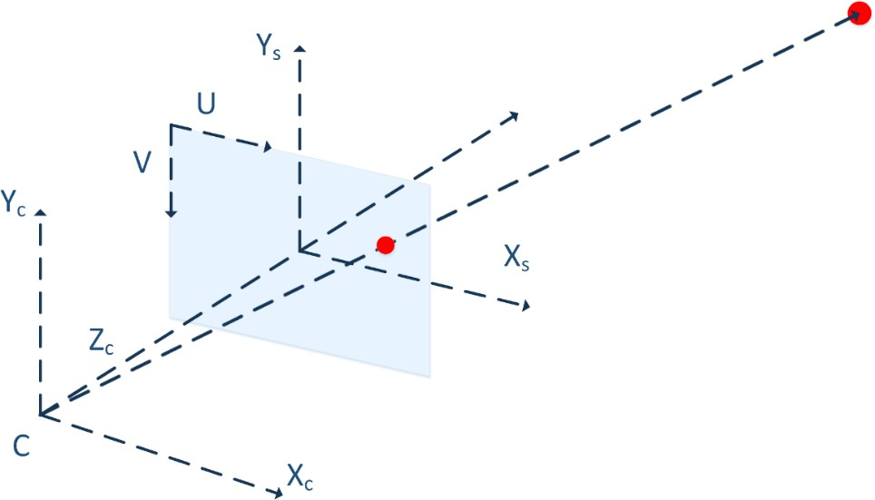
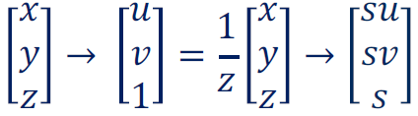
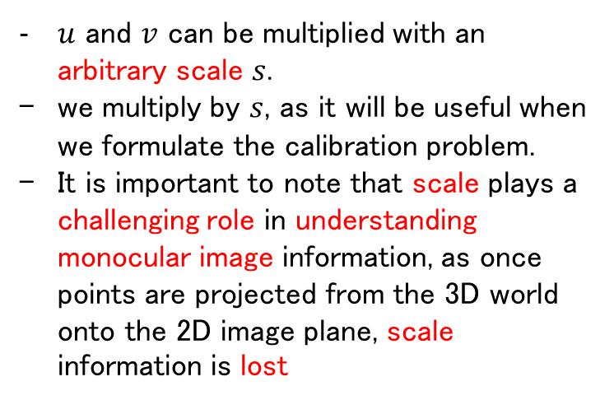
Computing the Projection
$u$ and $v$ can be multiplied with an arbitrary scale $s$.
we multiply by $s$, as it will be useful when we formulate the calibration problem.
It is important to note that scale plays a challenging role in understanding monocular image information, as once points are projected from the 3D world onto the 2D image plane, scale information is lost
World coordinates to Image coordinates:
Image coordinates to Pixel coordinates:
Scale: s
Points in 3D space along a ray from the camera center, all project to the same location on the image plane, and it is therefore not possible to directly associate a depth to a point given only image information.

Slide 24
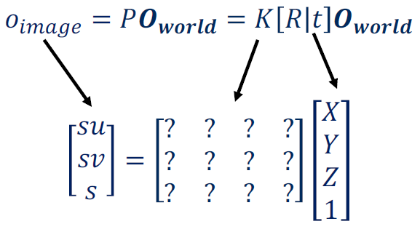
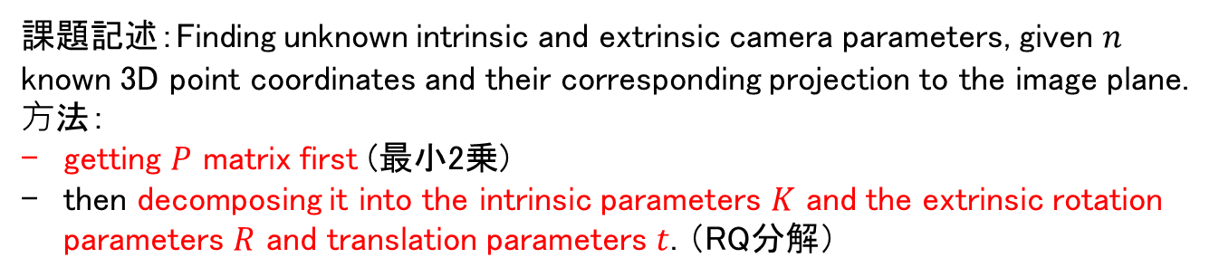
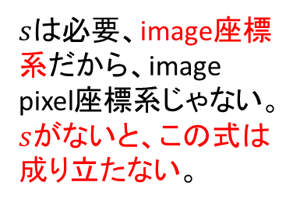
Camera Calibration: Problem Formulation
World coordinates and Camera coordinates known:
$sは$必要、image座標系だから、image pixel座標系じゃない。$s$がないと、この式は成り立たない。
課題記述：Finding unknown intrinsic and extrinsic camera parameters, given $n$ known 3D point coordinates and their corresponding projection to the image plane.
⽅法：
getting $P$ matrix first (最小2乗)
then decomposing it into the intrinsic parameters $K$ and the extrinsic rotation parameters $R$ and translation parameters $t$. （RQ分解）

Slide 25
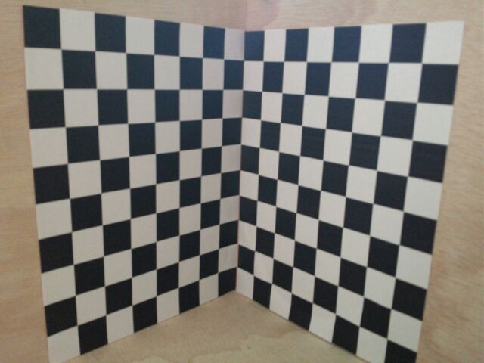
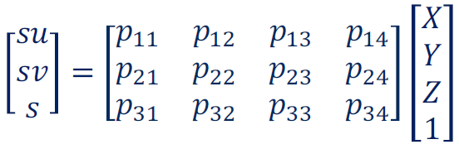
Camera Calibration: Problem Formulation
The most commonly used example would be a 3D checkerboard, with squares of known size providing a map of fixed point locations to observe.
Associating 3D points to 2D projections can be done either manually, or automatically, with checkerboard detectors.
Resolving the scale issue by measuring the actual 3D distance between the points that are observed in the image.
Use scenes with known geometry to:
Correspond 2D image coordinates to 3D world coordinates
Find the Least Squares Solution (or non-linear solution) of the parameters of !
Z_{w}
X_{w}
Y_{w}

Slide 26
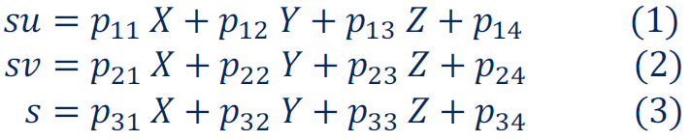
Camera Calibration: Problem Formulation
Expanding the equation results in:

Slide 27
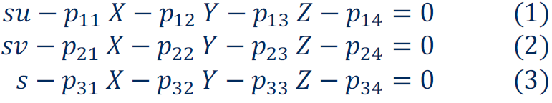
Camera Calibration: Problem Formulation
Move to LHS (left-hand side):

Slide 28
Camera Calibration: Problem Formulation
Replace Eq. (3) in Eq. (1) and Eq. (2) to get 2 equations per point:

Slide 29
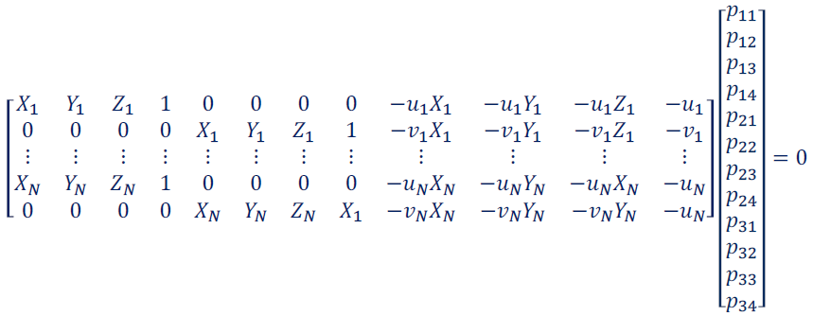

Camera Calibration: Problem Formulation
If we have N 3D points and their corresponding N 2D projections, set up homogeneous linear system
Solved with Singular Value Decomposition (SVD)
LidarのICPアルゴリズムにも使っていた
Since this is a homogeneous linear system, we can use the pseudo-inverse（擬似「ぎじ」逆行列） or even better, the singular value decomposition to get the least squares solution.
$$2N×12$$
12 parameters

Slide 30
Camera Calibration: Linear Methods
Advantages of such a simple linear system are:
Easy to formulate
Closed form solution
DCiasnadyvoaunthagineks of sumche adissiamdpvlaenltiangeeasr?system are:
Does not directly provide camera parameters
Does not model radial distortion（放射状歪み） and other complex phenomena
Does not allow for constraints such as known focal length to be imposed
Often provides really good initial points for non-linear calibration approaches.
Since we are solving via the linear least squares method, we cannot impose constraints on the solution, such as requiring the focal length to be non-negative.
MPC制御（モデル予測制御）のメリットの一つは簡単に制限条件を入れられることだと思う。

Slide 31
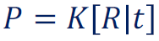
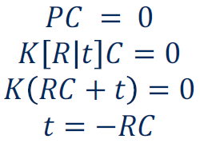
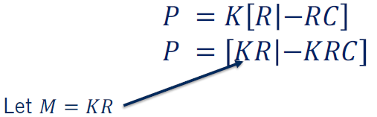
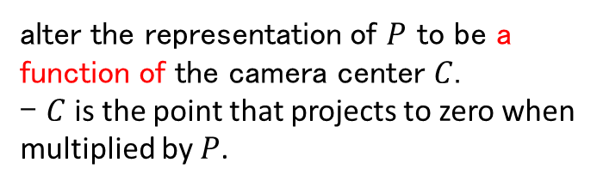
Factoring the P matrix
alter the representation of $P$ to be a function of the camera center $C$.
- $C$ is the point that projects to zero when multiplied by $P$.
Projection Matrix:
3D Camera Center projects to zero（次のスライド）:
Substituting in to projection matrix:

Slide 32
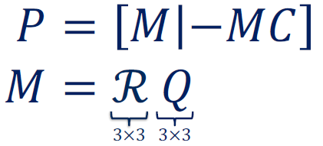
Factorizing the P matrix
use the fact that any square matrix can be factored into an upper triangular matrix（上「うえ」三角行列）and an orthogonal basis to decompose .
だからRQ factorizationという名前だ。
Which is a variant of the more commonly referred to QR factorization.
ℛ is not our Rotation Matrix!
カメラの内部パラメータ行列はまさに上三角行列。

Slide 33
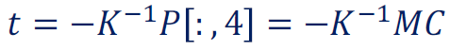
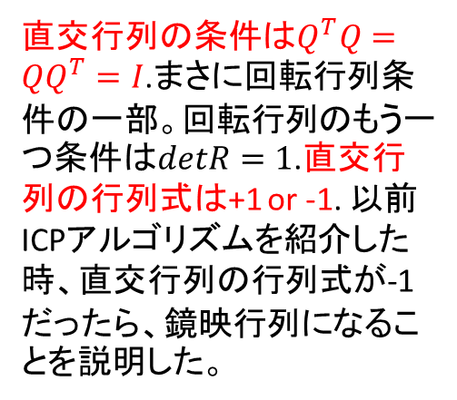
Factorizing the P matrix
M= ℛQ = KR
Intrinsic Calibration Matrix (upper triangular):
K = ℛ
Rotation Matrix (orthogonal):
R = Q
Translation Vector:
直交行列の条件は$Q^{T}Q=QQ^{T}=I$.まさに回転行列条件の一部。回転行列のもう一つ条件は$detR=1$.直交行列の行列式は+1 or -1. 以前ICPアルゴリズムを紹介した時、直交行列の行列式が-1だったら、鏡映行列になることを説明した。

Slide 34

Camera Calibration
Z_{w}
X_{w}
Y_{w}
Monocular camera calibration is a well-established tool that has excellent implementations in C+ +, Python and MATLAB.

Slide 35
Visual Depth（奥行） Perception: Stereopsis（立体視）
Course 3, Module 1, Lesson 3 – Part 1

Slide 36
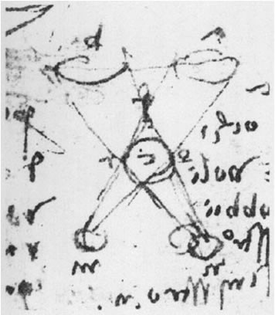
Stereopsis（立体視「りったいし」）
Charles Wheatstone（ホイートストン） (1838): “… the mind perceives an object of three dimensions by means of the two dissimilar（似ていない） pictures projected by it on the two retinæ（網膜「もうまく」） …’’
Pre 19th century: Leonardo da Vinci
Peter Hohenstatt:Leonardo da Vinci,1452-1519,Knemann Verlag,1998

Slide 37
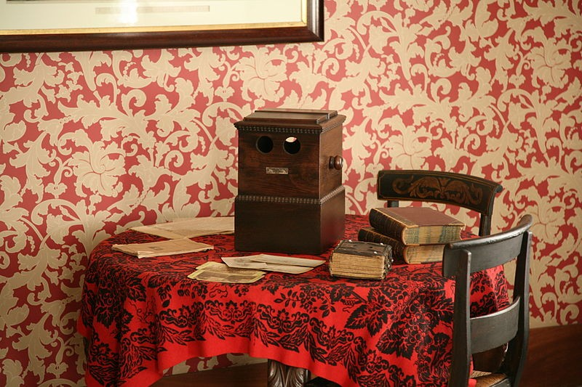
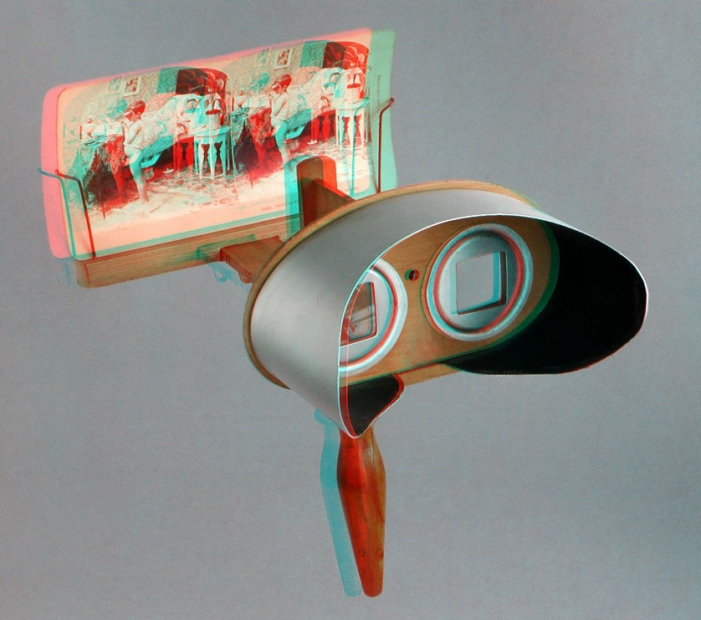
Stereoscopes: A 19th Century Pastime（娯楽「ごらく」）
https://commons.wikimedia.org/wiki/File:Lincoln_stereoscope.jpg
https://commons.wikimedia.org/wiki/File:Holmes_stereoscope_anaglyph_01.jpg
Anaglyph（アナグリフ）: a stereoscopic picture consisting of two images of the same object, taken from slightly different angles, in two complementary colors（補色「ほしょく」）, usually red and cyan (green-blue). When viewed through spectacles having one red and one cyan（シアン） lens, the images merge to produce a stereoscopic sensation.
Redとcyanは、chromatically opposite colors.
Complementary colors: pairs of colors which, when combined or mixed, cancel each other out (lose hue（色合い、色調）) by producing a grayscale color like white or black. When placed next to each other, they create the strongest contrast（コントラスト） for those two colors.
Modern color theory uses either the RGB additive color model or the CMY subtractive color model, and in these, the complementary pairs are red-cyan, green-magenta（マゼンタ）, and blue-yellow.

Slide 38



Stereo Cameras

Slide 39


Stereo Camera Model
A stereo sensor is usually created by two cameras with parallel optical axes(光軸「こうじく」).
To simply the problem even more, most manufacturers align the cameras in 3D space so that the two image planes are aligned with only an offset in the x-axis.
Given a known rotation and translation between the two cameras and a known projection of a point $O$ in 3D to the two camera frames resulting in pixel locations $O_{L}$ and $O_{R}$ respectively, we can formulate the necessary equations to compute the 3D coordinates of the point $O$.

Slide 40
Stereo Sensor: Assumptions
Sensor is constructed from two identical cameras
The two cameras have parallel optical axes
Project to Bird’s eye view for easier geometry

Slide 41




$b$, baseline, the distance along the shared x-axis between the left and right camera centers.
By defining a baseline to represent the transformation between the two camera coordinate frames, we are assuming that the rotation matrix is identity and there is only a non-zero x component in the translation vector.
The $[R|t]$ transformation therefore boils down to a single baseline parameter $b$.
KITTIではキャリブレーションファイルに$[R|t]$が提供されている。
Stereo Camera Model
問題記述：to compute the $X$ and $Z$ coordinates of the point $O$ with respect to the left camera frame.
The $y$ coordinate can be estimated easily after $x$ the $z$ and coordinates are computed.
上記の図に2つsimilar（相似「そうじ」） triangle equationsがある。

Slide 42

Computing 3D Point Coordinates
Disparity:
the difference between the image coordinates of the same pixel in the left and right images.

Slide 43


Computing 3D Point Coordinates
Main stereo relations:
P49を参考
Disparity $d$

Slide 44




Computing 3D Point Coordinates
Two main problems:
We need to know $f, b, u_{0}, v_{0}$
Use stereo camera calibration
$u_{0},v_{0}$は左カメラの光学中心
Zw
We need to find corresponding $x_{R}$ for each $x_{L}$
Use disparity computation algorithms
Xw
Yw

Slide 45
Visual Depth Perception: Computing The Disparity
Course 3, Module 1, Lesson 3 – Part 2

Slide 46


Computing 3D Point Coordinates
Two main problems:
We need to know $f, b, u_{0}, v_{0}$
Use stereo camera calibration
We need to find corresponding $x_{R}$ for each $x_{L}$
Use disparity computation algorithms
Stereo equations:

Slide 47

Computing 3D Point Coordinates (Review)
Disparity: The difference in image location of the same 3D point under perspective to two different cameras
Correspond pixels in the left image to those in the right image to find matches
Brute Force Solution:
o Search the whole image for each pixel?
The stereo correspondence problem.
It’s also unlikely to succeed as many pixels will have similar local characteristics, making it difficult to match them correctly.
Luckily, we can use stereo geometry to constrain the search problem from 2D over the entire image space to a 1D line.
Why such a simplification is valid?

Slide 48





























Epipolar（エピポーラ） Constraint for Correspondence
YY_{LL}
Epipolar Line
ZZ_{LL}
YY_{RR}
ZZ_{RR}
XX
CC_{LL}
CC_{RR}
Move the 3D point along the line connecting it with the left camera’s center.
The projection on the right camera plane, moves along the horizontal line（水平線）. (Epipolar line)
We can constrain our correspondence search to be along the epipolar line, reducing the search from 2D to 1D.

Slide 49




Non-Parallel Optical Axes
Horizontal epipolar lines only occur when the optical axes of the two cameras are parallel.
If this condition is not met, epipolar lines will be skewed
o Known as multi-view geometry
Epipolar Line
斜めの
C_{L}
単眼SLAMとほぼ同じ。ステレオは左右カメラのframeだが、単眼SLAMでは前フレームと現フレーム。
C_{R}

Slide 50



Disparity Computation
Image rectification: https://en.wikipedia.org/wiki/Image_rectification
We can use stereo rectification（整流） to warp images originating from two cameras with non-parallel optical axes to force epipolar lines to be horizontal.
In the case of stereo camera, a skewed epipolar line is not a huge problem.
stereo rectificationの実現も既にある。(available in standard computer vision packages such as OpenCV and MATLAB)
CLL
C_{R}
C_{R}

Slide 51

A basic Stereo Algorithm
Given: Rectified Images and Stereo Calibration. For each epipolar line,
Take each pixel on this line in the left image
Compare these left image pixels to every pixel in the right image on the same epipolar line
Pick the pixel that has minimum cost
Compute disparity, d
for example, a very simple cost can be the squared difference in pixel intensities.
d

Slide 52






Stereo Matching
Stereo matching is a very well-studied problem in computer vision
Survey at: http://vision.middlebury.edu/stereo/eval3/
As with most problems in computer vision, the stereo vision algorithms are evaluated on a public benchmark.
• The most famous of which is the middlebury stereo benchmark.

Slide 53
Image Filtering
Course 3, Module 1, Lesson 4

Slide 54

Image Filtering
Image Filtering is a simple and efficient method to eliminate noise.
How image filtering helps reduce salt and pepper noise（塩コショウノイズ）.
Copyright Massachusetts Institute of Technology

Slide 55




Image Filtering
outlier pixels, low-value pixels in a high-value neighborhood, or high-value pixels in a low-value neighborhood.
One idea to reduce this noise is to compute the mean of the whole neighborhood, and replace the outlier pixel with this mean value.
0 | 0 | 0 | 90 | 90 | 90
0 | 0 | 0 | 90 | 0 | 90
0 | 0 | 0 | 90 | 90 | 90
0 | 0 | 0 | 0 | 0 | 0
0 | 90 | 0 | 0 | 0 | 0
0 | 0 | 0 | 0 | 0 | 0
0 0 0 90 90 90
0 0 0 90 80 90
0 0 0 90 90 90
0 0 0 0 0 0
0 10 0 0 0 0
0 0 0 0 0 0
(2k+1): Filter size
(u, v): Center pixel coordinates

Slide 56


Cross-Correlation
The mean equation can be generalized by adding a weight to every pixel in the neighborhood.
The weight matrix is called a kernel.
This generalized form is termed cross-correlation（相互相関）, as it defines a correlation between each pixel and every other pixel in the neighborhood.
$I[u+i,v+j]$の方が正しいと思う。
この式は畳み込みだと思う。ここは実はinputとkernelの掛け算は既にひっくり返している。次のスライドへ
where the center pixel is weighted more than the neighboring pixels and the weights follow a Gaussian distribution.
効果：It also blur（暈す「ぼかす」） the image, an inevitable consequence of these linear filters.

Slide 57


Cross-Correlation
Mean Filter
Gaussian Filter

Slide 58

Convolution
A convolution is a cross-correlation where the filter is flipped both horizontally and vertically before being applied to the image
CNNは畳み込みという名前だが、cross-correlationで実現することも多いと思う。[Deep Learning p324: While the commutative property is useful for writing proofs, it is not usually an important property of a neural network implementation. Instead, many neural network libraries implement a related function called the cross-correlation, which is the same as convolution but without flipping the kernel.]

Slide 59



ConvolutionやCross-correlationの式 from Deep Learning 9.1 The Convolution Operation
https://www.deeplearningbook.org/contents/convnets.html
ここは$m,n$の範囲は変わるだけ。

Slide 60


ConvolutionとCross-correlationのプロパティ
Convolutionは結合性（associativity）や可換性（commutativity）両方を持っている。
https://en.wikipedia.org/wiki/Convolution#Properties
可換性 http://16720.courses.cs.cmu.edu/lec/convolution_lec1.pdf ：
Cross-correlationは可換性も結合性も持っていない。
結合性がないのはまだ理解できていない

Slide 61

Convolution
[Deep Learning p328]The only reason to ﬂip the kernel is to obtain the commutative property.
https://www.deeplearningbook.org/contents/convnets.html
Unlike Cross-Correlation, Convolution is associative. If H and F are filter kernels then:
Precompute filter convolutions (H∗ F) then apply it once to the image to reduce runtime!
複数フィルターをかける場合はconvolutionを使うが、１つフィルターなら、cross-correlation, convolutionはそんなに差がないと思う。
例えば、Gaussian Filterでsmoothingして、sobel kernelをかける場合、このメリットを利用できると思う。

Slide 62





Applications: Template Matching
問題記述：Template matching is the problem where given a pattern or a template, and we want to find its location in the image.
Cross-correlation is useful for template matching
The pixel with the highest response from Cross- correlation is the location of the template in an image
∗
=
Template
This method can be used as a starting point for the identification of signs, and even for lane detection.
この例からcross-correlationの画像インプットとカーネルの掛け算はflipしないことが分かる。

Slide 63












Applications: Gradient Computation
We can rotate the kernel in different orientations to get vertical, horizontal or even diagonal gradients of an image at a pixel.
Image gradients are extremely useful for detection of edges and corners.
keypointのdescriptorは2種類、gradient-basedやbinary. なので大事。またsobel kernelはgradientを計算するwell-proven standard approach (udacity).
Convolution can be used for Image gradient computation
Define a finite difference kernel, and apply it to the image to get the image gradient
1 | 2 | 1
0 | 0 | 0
-1 | -2 | -1
極端の場合、画像の縦方向のピクセルが全部一緒だったら、横Sobel kernelをかけると、結果は０。
∗
=
Horizontal Sobel Kernel
finite difference, 有限差分: Three types are commonly considered: forward, backward, and central finite differences.

Slide 64



Image Filters and Gaussian Smoothing (from Udacity)
To counteract noise, especially under low-light conditions, a smoothing operator has to be applied to the image before gradient computation.
Usually, a Gaussian filter is used for this purpose which is shifted over the image and combined with the intensity values beneath it.
Gaussian filterの２つパラメータ：
The standard deviation: the larger the standard deviation, the wider the area which is covered by the filter. つまり分布を決める。小さければ小さいほど確率密度関数が尖る。
The kernel size: defines how many pixels around the center location will contribute to the smoothing operation. これはCNNのfilterのkernel sizeと同じ意味だろう。
Gaussian kernelは必ず$∑k\left(i,j\right)=1$を保証すること。

Slide 65










Compute the Intensity Gradient (from Udacity and Wiki)
Sobel operator: https://en.wikipedia.org/wiki/Sobel_operator
$S_{x}$適用
$${G_{x}=S}_{x}∗I$$
$S_{y}$適用
$${G_{y}=S}_{y}∗I$$
上記2枚を合わせた結果：
Magnitude: $G=\sqrt{G_{x}^{2}+G_{y}^{2}}$
Orientation: $Θ=atan⁡(\frac{G_{y}}{G_{x}})$

